Slide 2
"Promote health, prevent diseases and foster supportive environments for healthy lifestyles" Andrew Barnfield Work Package Leader, Health Promotion EuroHealthNet, Brussels Chronic diseases: key objectives of CHRODIS Joint Action & JA CHRODIS PLUS
Notes:
Thank you to the organisers for the opportunity to come to Sarajevo and speak with you about Chrodis and Chrodis Plus. I’m standing in for the coordination team from Carols the third in Spain and Vilnius university hospital in Lithuania. I would especially like to thank Rokas Navickas the Scientific Coordinator of Chrodis Plus for the slides that he delivered at the dissemination event in Brussels a few weeks ago.
In this presentation I will introduce Chrodis Joint Action and explain the process and the results. I will then move onto to dicuss the work that we are carrying out in Chrodis Plus. I will finish with the current and expected impact on the number citizens within Europe a s a direct result of our work.

Slide 3
What is JA-CHRODIS
A Joint Action under the EU health programme
39 associated partners + 32 collaborating partners, from 25 countries
9.2 M€ co-funded 50% by EC
3 years duration (January 2014 – March 2017)
Notes:
Addressing chronic diseases health promotion and primary prevention, multimorbidity, and diabetes

Slide 4
The objective
to identify, exchange, scale-up and transfer good practices and effective interventions on
health promotion and chronic disease prevention,
multi-morbidity
diabetes
based on a Platform for Knowledge Exchange
Notes:
Based on existing approaches to define good practice and a review of existing databases and literature,
a consensus panel of European health promotion experts defined key criteria for the identification of
good practice examples.
Final set of criteria recommended for evaluating HPPP interventions:
Equity
Comprehensiveness of the intervention
Ethical Considerations
Evaluation
Empowerment and Participation
Target population
Sustainability
Governance and project management
Potential of scalability and transferability

Slide 5
What is a “good practice”?
“A good practice is not only a practice that is good, but a practice that has been proven to work well and produce good results, and is therefore recommended as a model. It is a successful experience, which has been tested and validated, in the broad sense, which has been repeated and deserves to be shared so that a greater number of people can adopt it.”
Notes:
The JA CHRODIS defines ‘good practice’ in accordance with the definition by the Food and Agricultural
Organization of the United Nations

Slide 6
Results
41 good practice examples from 13 partner countries
ToyBox Intervention
Active School Flag
Young People at a Healthy Weight ´JOGG´
Multimodal Training Intervention
Lombardy Workplace Health Promotion Network
Notes:
A broad thematic range of interventions across the life cycle and for various settings as well as examples of policies and strategies.
TOYBOX (Greece) European- wide, kindergarten-based, family-involved intervention, focusing on the promotion of healthy snacking and physical activity in preschool children. Pre-natal environment, early childhood, childhood and adolescence.
ACTIVE SCHOOL FLAG (Ireland) Initiative which aims to enhance levels of physical activity for children through developing a physically active and physically educated school community. Open to all primary, post-primary, special needs education schools and YouthReach centres. Pre-natal environment, early childhood, childhood and adolescence.
JOGG (The Netherlands) Community approach in which parents, health professionals, shopkeepers, companies, schools and local authorities collaborate to promote healthy weight to young people (0-19 years), with each city having a JOGG-coordinator planning the various activities. Pre-natal environment, early childhood, childhood and adolescence.
MULTIMODAL (Iceland) 6-month intervention promoting healthy ageing to older adults, with an emphasis on physical activity. Healthy Ageing.
LOMBARDY WORKPLACE HP (Italy) Public-private regional network of associations of enterprises, trade unions and the health system. As part of the European Workplace Health Promotion Network, member companies should implement good practice informational and organisational activities in key areas such as nutrition, tobacco, physical activity, and alcohol. Adulthood.

Slide 7
CHRODIS PLUS
CHRONIC DISEASES; IMPLEMENTATION; POLICY IMPACT
Notes:
Europe is paying a heavy price for chronic diseases (CD): it has been estimated that CD cost EU economies 115 billion € or 0.8% of GDP annually; and this figure does not include the additional loss in terms of lower employment rates and productivity of people living with chronic health problems. CHRODIS+ Joint Action is a three-year initiative (2017-2020) funded by the European Commission and the participating organizations.
The overarching goal of CHRODIS+ is to support Member States through cross-national initiatives identified in JA-CHRODIS to reduce the burden of CHRONIC DISEASES, increase the sustainability of health systems and develop human capital.
CH+ is one of few Joint actions where actual/practical implementation takes a big part of the project. In order to ensure the sustainability and scalability of implemented good practices we have to take this action to the next level and a big role bears to Policy Dialogues with an aim to increase decision-makers’ awareness and acceptance of improved actions to combat chronic diseases. They will result in guidance for health sector stakeholders to achieve POLICY IMPACT

Slide 8
CHRODIS PLUS: content and objective
Implement
Identify best practices
Define transfer strategy
Evaluate and prepare for scale up
Notes:
Europe has never been more fragile, projects like that bring the community together- through common goals, directed to actual gains for our citizens. CH+ have clearly defined objectives and steps to reach them.
[CLICK]
First innovative practices were identified based on the collection of policies, strategies and interventions that started in JA-CHRODIS and in its outputs such as the Integrated MultiMorbidity Care Model or the Recommendations for Diabetes Quality criteria or national plans.
[CLICK]
Then we have established a cross-WP common strategy to ensure a common overall CHRODIS-PLUS methodological approach towards the general aim of implementing new or innovative policies and practices.
[CLICK]
The cross-national IMPLEMENTATION of these innovative practices is being promoted by CHRODIS+ supporting the cross-national collaboration of local implementers and maximizing the dissemination of the lessons learnt through a clear strategy engaging the appropriate stakeholders, promoting the integration and sustainability of the novel, inter-sectorial approaches to health promotion and disease prevention and CD care into national policies.
CH+ implementers are considered as motivated early adopters, supporting the implementation and adjusting it to local healthcare needs, proving the concept and preparing it for the scale up.
[CLICK]
The final step will be Evaluate our work and prepare for scale up. KEY objective is to show how identified good practices can be converted into real life in another country with a direct benefit for patients

Slide 9
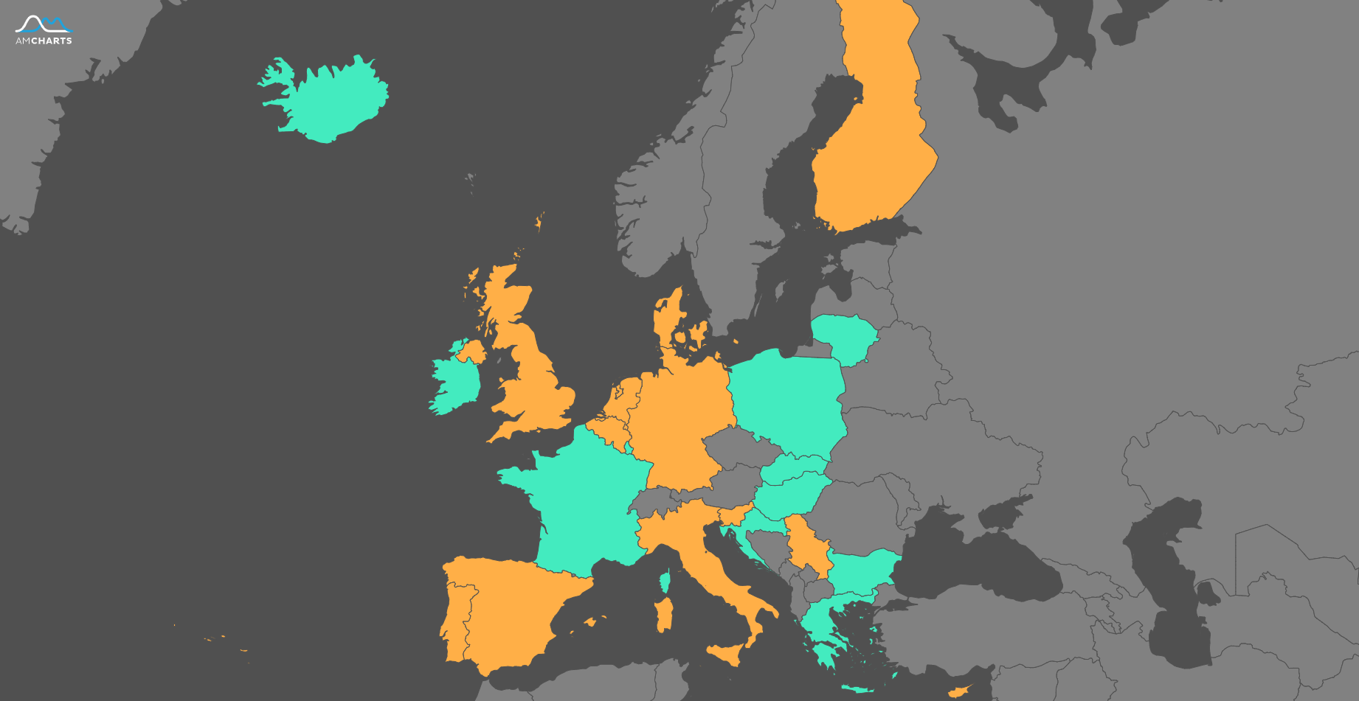
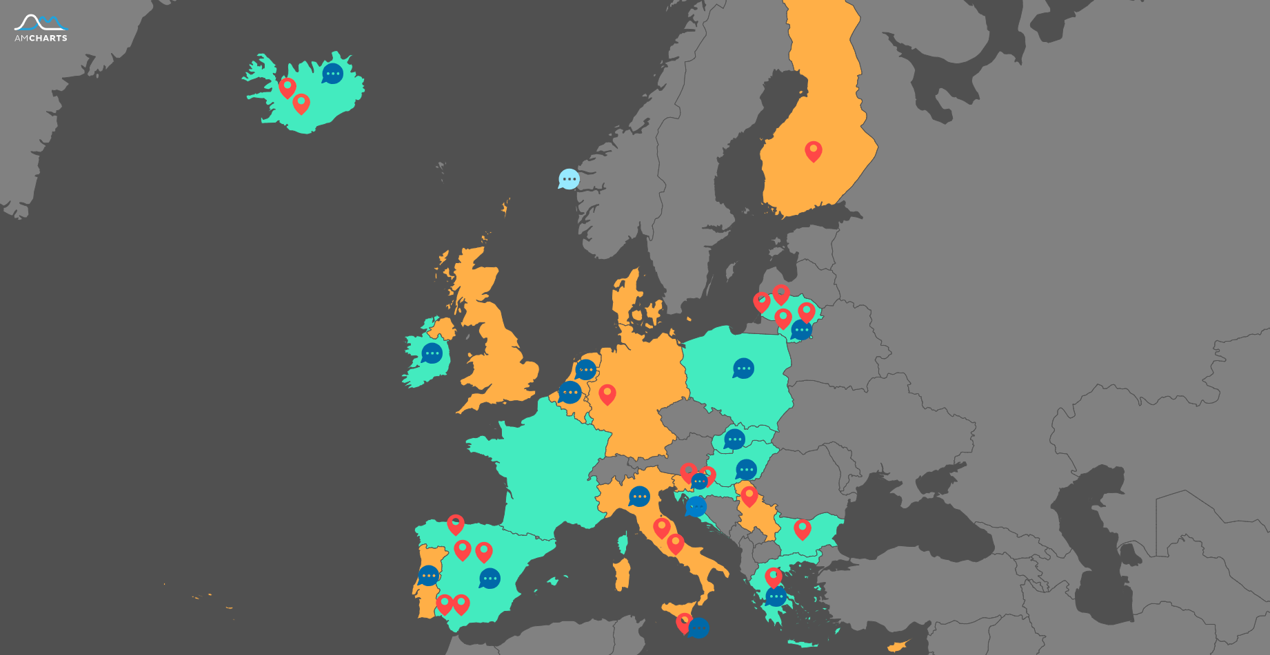
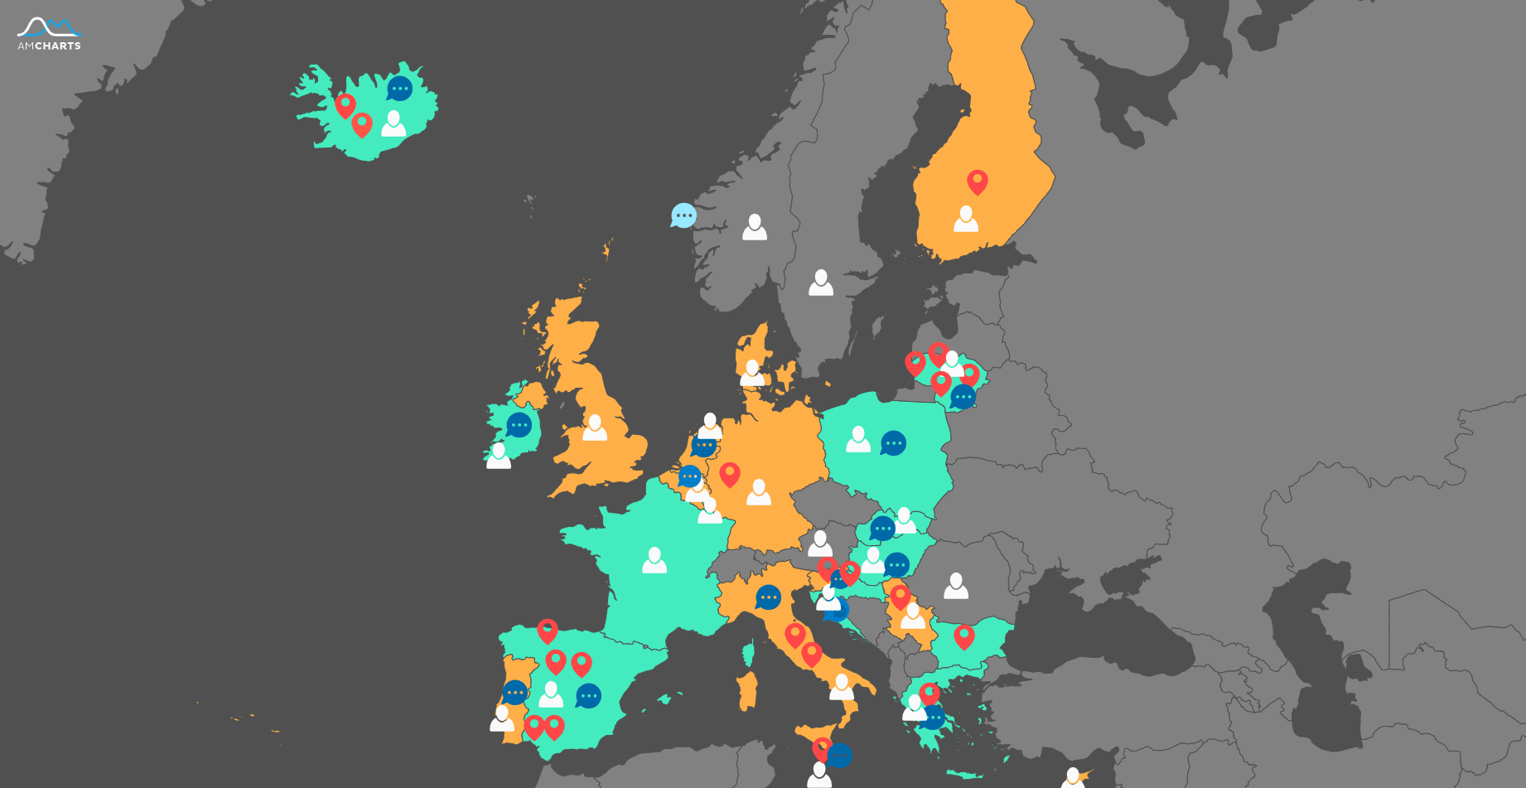
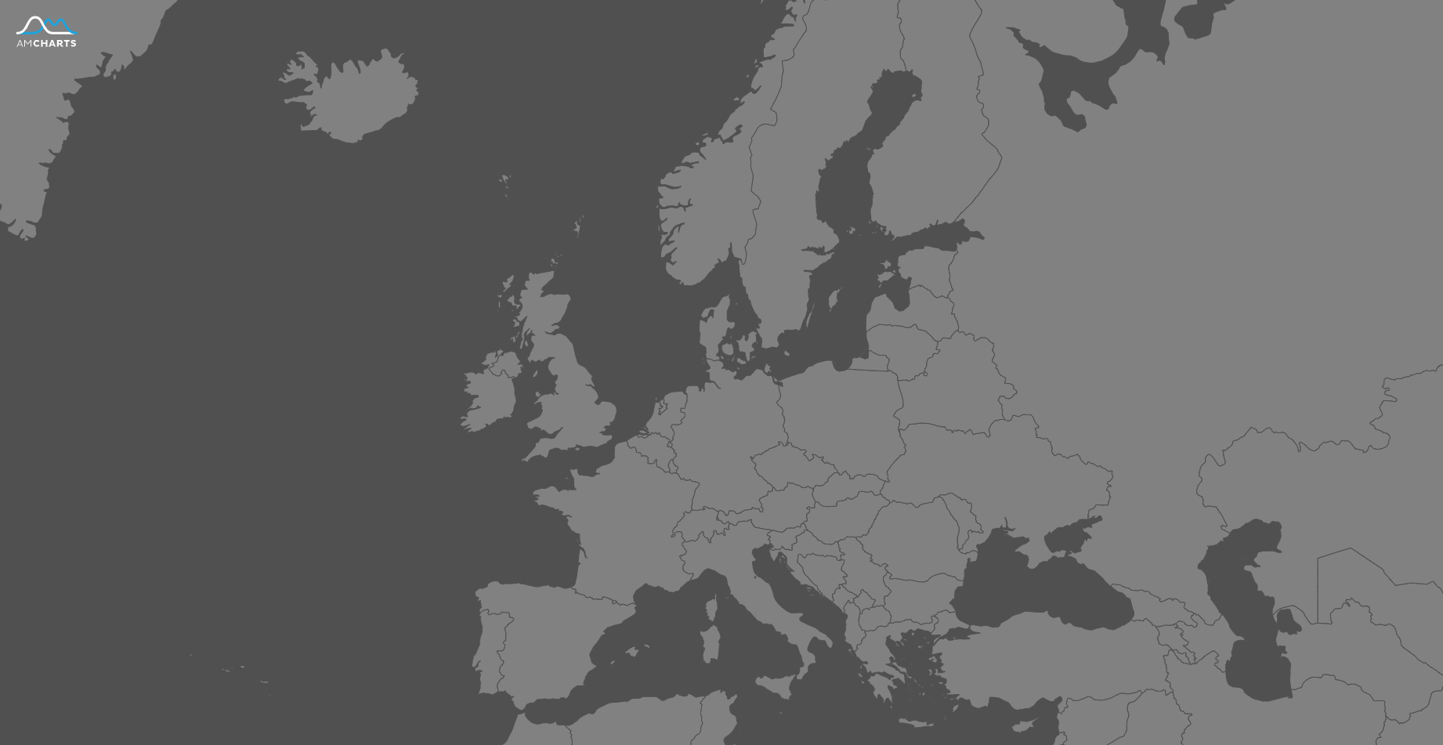
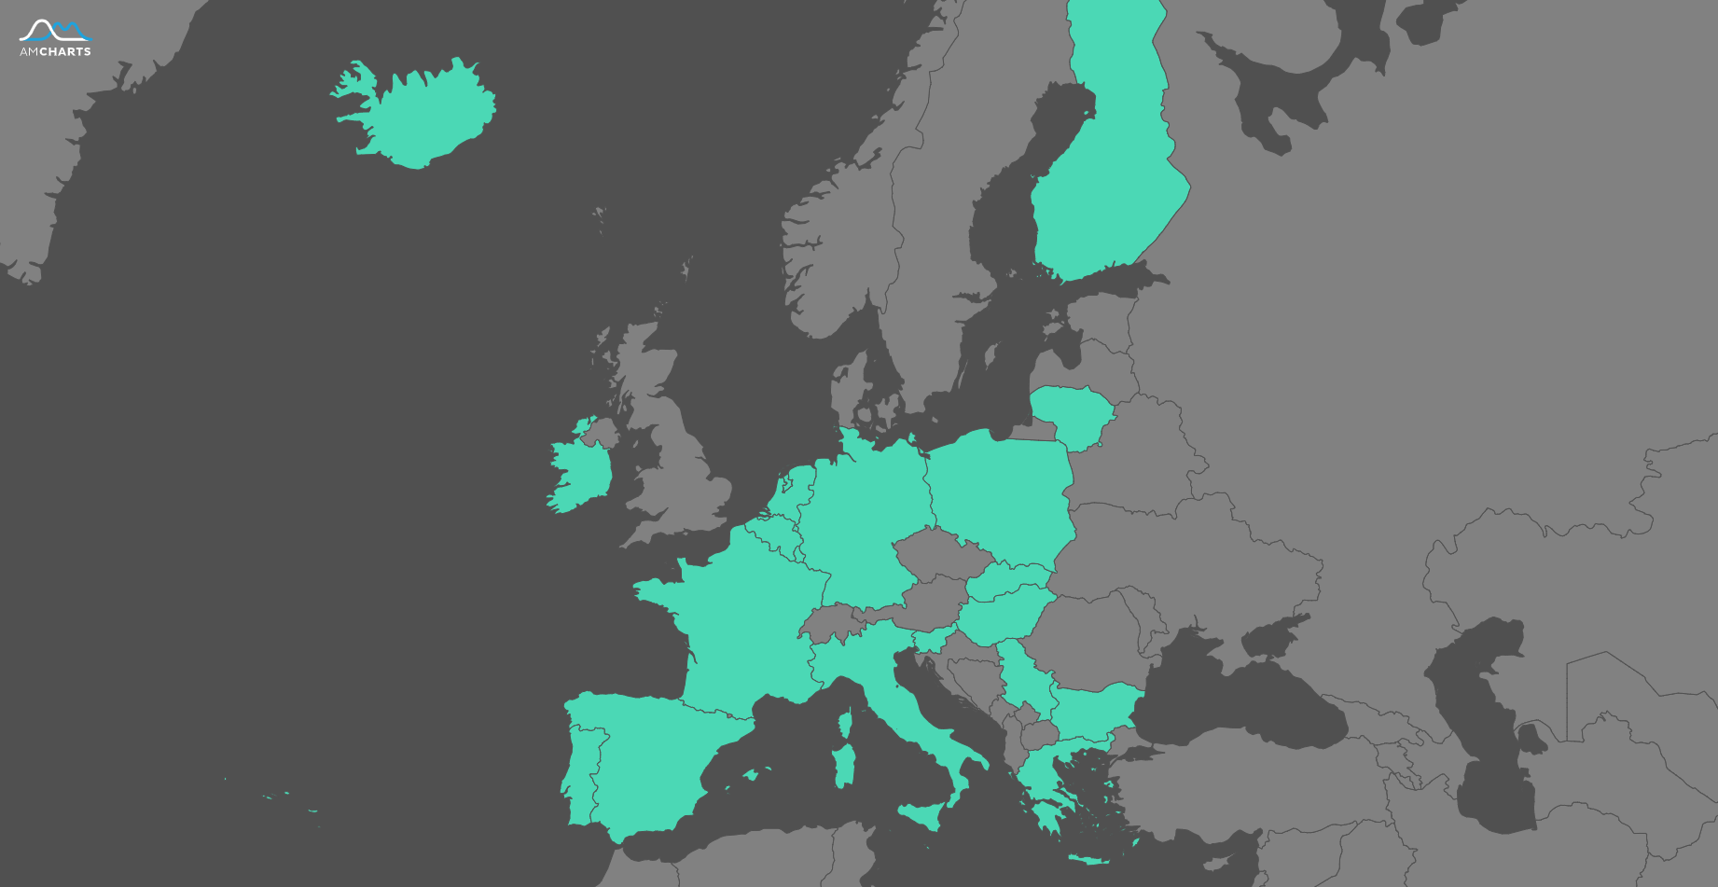
Notes:
CLICK]
So what is the scope of CH+ and what have we reached so far. CH+ is an action that involves a total of 42 beneficiaries representing 20 European countries.
[CLICK]
The CHRODIS PLUS raises more and more interests for relevant stakeholders and 12 Collaborating partners have joined forces to expand CH+ scope.
[CLICK]
More than 21 pilot site (RED marks) are successfully running implementation and 17 Policy dialogues (BLUE marks) in several countries (15 countries) and at the EU level (2) with the ultimate aim to provide a proposal of tangible actions in order to have country specific impact for better management of CD.
[CLICK]
In addition to everything already mentioned the CHRODIS PLUS Governing Board (GB) is established in order to set up an appropriate framework for the participation of EU and EEA Member States and Serbia in the Joint Action CHRODIS PLUS (JA-CHRODIS PLUS).
The GB National representatives serves as liaison between their National Health System and JA-CHRODIS PLUS. This will facilitate the sustainability and development of this Joint Action (JA) beyond the 3-years of the expected EU funding commitment.

Slide 10
CHRODIS PLUS: uptake and follow-up
Scalable interventions
OECD
OECD
OECD
SGPP
Governing Board
Consensus statement
15 national
2 EU level
⇧
15 national
2 EU level
CP
CP
CP
Scientific network
Scientific network
Scientific network
Synergies
Policy dialogues
Sustainability
Synergies
Policy dialogues
Synergies
Notes:
In my view Chrodis plus joint action is a good practice trampoline and with a design that is destined to succeed:
[CLICK]
Gathered professional scientific network by identifying good practices and relevant stakeholders, developing local impl. Working Groups and attracting potential collaborators. CH+ is also looking forward to OECD involvement which is due to come. This will raise CH+ deliverables usability even more with clearly assessed monetary outcomes.
[CLICK]
The “reality check” of good practices providing splendid results across Europe (and beyond it) empowers us to facilitate a political debate on a national level to support the implementation and encourage the scaling up of the practices, aimed at reducing the burden of non-communicable diseases, while assuring health systems sustainability and responsiveness.
CH+ partners will organize 17 policy dialogues. A policy dialogue is an essential component of the policy and decision-making process, where it is intended to contribute to informing, developing or implementing a policy change following a round of evidence-based discussions, workshops, and consultations on a particular subject.
[CLICK]
In order to make our products sustainable we aim to involve ministries in a national as well as EU level. A board comprised of representatives from the Ministries of Health of all of all countries participating in CHRODIS PLUS (Governing Board - GB) has been set up to favour policy discussions at ministerial level.
CHRODIS PLUS have proposed SGPP - the Steering Group on Health Promotion, Disease Prevention and Management of Non-Communicable Diseases (the short title is the Steering Group on Promotion and Prevention) concrete ways to interact with CH+. The aim is to increase European and multi-country collaboration for health promotion and prevention and control of non-communicable diseases (NCDs) while making best use of the current and future available EU resources.
And of course one of our main JA outputs will be a policy-level position paper (“Consensus Statement”). This paper will guide future work in Europe on non-communicable diseases with a focus on EU added --value of cross-country collaboration in the field of NCD.

Slide 11
CHRODIS PLUS: benefits for EU citizens
Direct benefit to 7817 number of EU citizens (and rising)
Indirect benefits through publicity, patient environment, scientific network.
Added value to Member states
Notes:
Critical situations require a complex and unified response. CHRODIS PLUS envisions a Europe free of preventable diseases and NOW is the time each stakeholder needs to prepare in order to maximise the benefits of CHRODIS PLUS outcomes in their country/institution, so I invite everyone who is in a position to stimulate changes to join forces.
With CH+ we would expect benefits for all:
Policy makers-Provide evidence on effective interventions that can represent the basis to inform policy
Stakeholders-Provide a cost-effective effective intervention to be applied in different contexts
Patients-Receive comprehensive of care centered on needs
With more than 21 pilot sites successfully running implementation of the good practice we have directly reached 7817 EU citizens (and rising) and brought significant change in their life.
Indirect benefits through publicity, patient environment, scientific network is a 10 or even 100 times bigger. Just to understand this i can give one pilot site example where planned impact to number of patients/citizens at the end of implementation is 324 000. The Directorate of Health (DOHI, Iceland) will implement (elements of) JOGG within the “Health Promoting Community Programme” (HPC), an umbrella for comprehensive health promotion work in municipalities, including Pre-, Compulsory- and Upper secondary schools. Its main aim is to support communities/schools to create supportive environments that promote healthy lifestyle, health and well-being for all.More municipalities are joining and for example by the end of October at least 91%* of the population will live in a Health promoting community *Of 356.991 (total population in Iceland January 2019).
Added value to Member states can be described by another example of successful implementation of “Multimodal Training Intervention in Communities an Approach to Successful Aging”. The program has received quite a lot of publicity, both in connection with Chrodis+, the implementation in Spain and Lithuania and last but not least in Icelandic media. The good practice owners get a lot of enquiries about the program, and many municipalities have now shown strong interest in implementing it in Iceland. The government is also showing an interest in participating in the costs of the program in the municipalities since it greatly benefits the Icelandic state as a whole (not just the municipalities). It does not surprise me because if we are able to delay the transition of our current 400 participants into a health institution, then we are talking about savings EUR 38-44 million for each year we manage to delay the transition of the whole group. Note that these savings are only accounting for the direct costs related to housing the people in a health institution. The number therefore excludes costs such as medicine, medical procedures etc

Slide 12
For more information
http://chrodis.eu/

